Slide 1

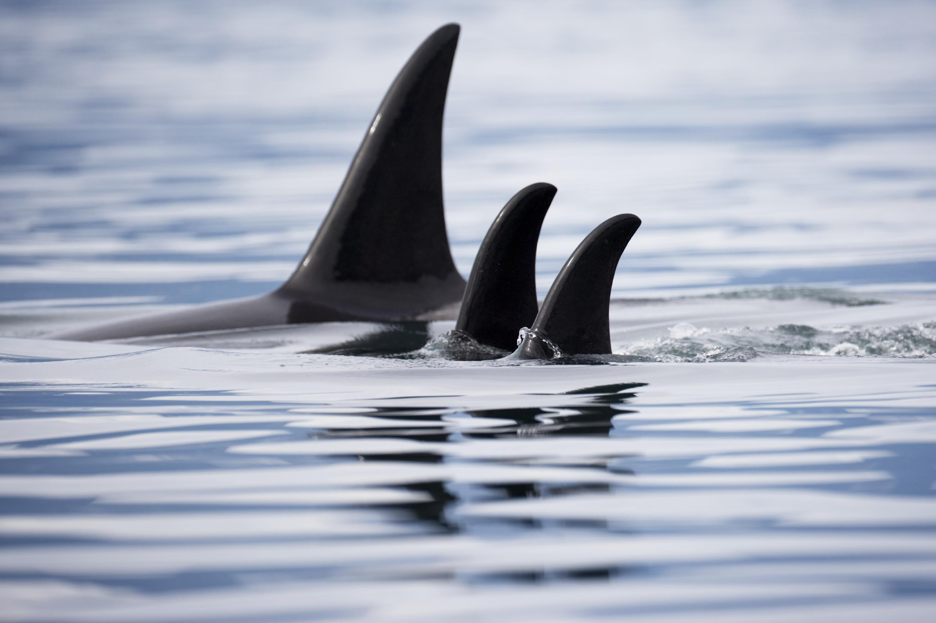

SHARKS NETBALL
CLUB PLAN
FINS UP IN 2026

Slide 2
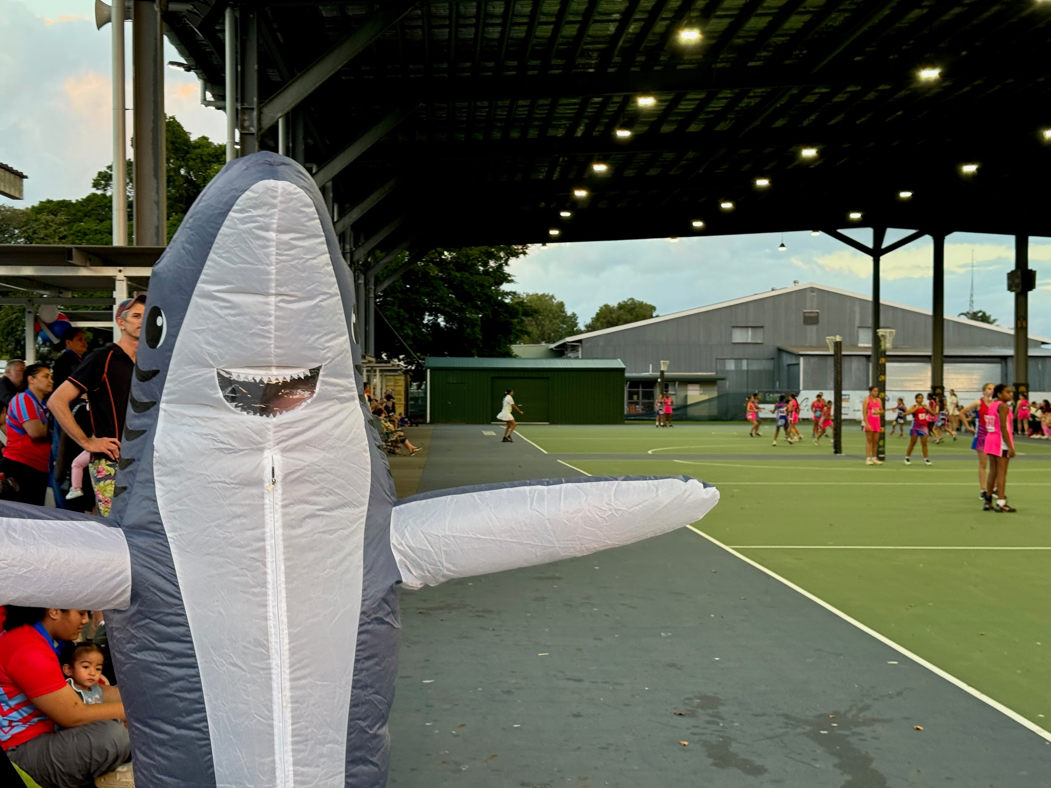
WHY WE ARE SHARKS
Sharks Netball Club is dedicated to fostering an inclusive, supportive, and vibrant community where players, volunteers, officials, and families feel valued and welcome. Regardless of skill level, every individual has a place in our club and on the court. We are committed to developing exceptional coaches who empower our players to grow and excel. By leading with integrity, passion, and teamwork, we strive to make Sharks Netball Club and by extension Cairns Netball Association a destination where people who love the game come to play, thrive, and belong.

Slide 3
COACHING IN 2026
TOP 3 FOCUS AREAS
Communication and collaboration
Mentoring and Support
Resources and Training
HOW WE WILL DO THIS
  Provide coaches with resources required (coaching app access).
  Monthly coaching meetings with all coaches.
  Support all coaches to have min Foundation qualification.
  Introduction of coaching mentoring program and coaching manual.
  Junior coaches will always be paired with an experienced coach.
  Combine training session once a month.

Slide 4
CLUB CULTURE IN 2026
TOP 3 FOCUS AREAS
Have clear expectations and values around training and commitment to club.
Breakdown the divide between teams/divisions/juniors/seniors.
Bringing some fun and social events back into the club and build the community.
HOW WE WILL DO THIS
  Clear communication to all players at the start of the season about expectations for training and club culture.
  Senior players to adopt a junior team to support at games and in training sessions.
  All players and supporters need to know "fins up"
  More social events that are easy to attend i.e. "Game of the Week" where club supports a team a week, season commencement event once teams are named.

Slide 5
PLAYER DEVELOPMENT IN 2026
TOP 3 FOCUS AREAS
Focus on player wellbeing (emotional, physical, nutrition, injury prevention, S&C etc)
Support our juniors moving into seniors.
Ensure there are development opportunities for all players.
HOW WE WILL DO THIS
  Structured pre-season and sessions throughout the season that provide players and supporters with education about players wellbeing.
  Ensure managers and coaches know how to respond to player concerns/issues or complaints or when there is a concerns about players wellbeing.
  Policy around team selections is publicised prior to trials.
  Invite juniors who are looking to move to seniors the opportunity to train with seniors to help them prepare for the move into senior competition

Slide 6
SHARKS COMMITTEE IN 2026
TOP 3 FOCUS AREAS
Recruiting senior players and parents of juniors into the committee.
Sharing the workload.
Skills based recruitment to the committee.
HOW WE WILL DO THIS
  Build and clear agreed vision for 2026 with a clear action plan.
  Introduce subcommittees- don’t need to be on committee but can undertake one off activities such as overseeing pie drive etc
  Actively engage with club members and seek to understand skills that members may have that could be useful to the club
  Committee to continue to lead by example and foster club culture.

Slide 7
FUNDRAISING/SPONSORSHIP IN 2026
TOP 3 FOCUS AREAS
Improving sponsorship acknowledgement and ROI for sponsors.
How can we encourage volunteer- targeting new and old Sharks.
Diversify fundraising opportunities and communicate more with players and supporters with a clear message around why fundraising matters
HOW WE WILL DO THIS
  Map out new fundraising opportunities
  Appoint a sponsorship/fundraising coordinator who oversees grants, fundraising and new sponsor opportunities.
  Have a social media calendar that has scheduled SM pushes for our sponsors.
  Focus on sponsors who align with women's participation.

